Slide 1
Fundamentals of Ecology
Week 8, Ecology Lecture 7
Cara Brook
February 27, 2025
Office hours: On ZOOM
Friday, Feb 28, 2025
4-5pm
I will email out a link!

Slide 2
Learning objectives from Lecture 6
You should be able to:
Add

Slide 3



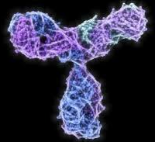

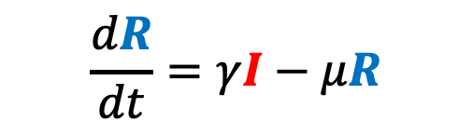

We can adapt the simple SIR model to better match our pathogen of interest and our corresponding data.
$$\frac{dS}{dt}=b(S+I+R)−βSI−μS$$
deaths
deaths
deaths
μ
μ
μ
transmission
recovery
births
$$\frac{dI}{dt}=βSI−γI−μI$$
β
γ
b
S
Susceptible
I
Infectious
R
Recovered
$$\frac{dR}{dt}=γI−μR$$

Slide 4

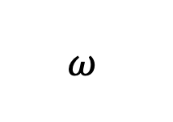
Incorporating Maternal Immunity
deaths
births
deaths
deaths
deaths
μ
μ
μ
μ
b
recovery
transmission
births
$$ω$$
β
γ
b
M
Maternally immune
S
Susceptible
I
Infectious
R
Recovered

Slide 5


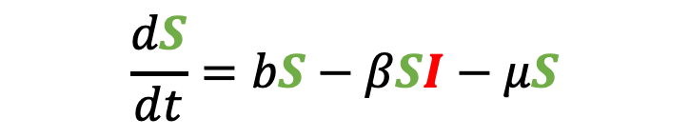
Incorporating Maternal Immunity
deaths
births
deaths
deaths
deaths
μ
μ
μ
$$\frac{dS}{dt}=bS−βSI−μS$$
μ
b
recovery
transmission
births
$$ω$$
β
γ
b
M
Maternally immune
S
Susceptible
I
Infectious
R
Recovered
$$\frac{dI}{dt}=βSI−γI−μI$$
$$\frac{dR}{dt}=γI−μR$$
What does our new equation look like?

Slide 6
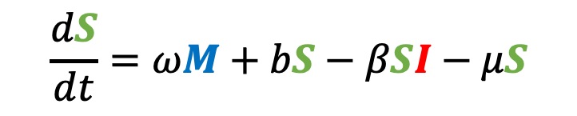
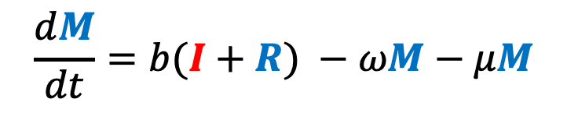
Incorporating Maternal Immunity
$$\frac{dM}{dt}=b(I+R) −ωM−μM$$
deaths
births
deaths
deaths
deaths
μ
μ
μ
μ
b
recovery
$$\frac{dS}{dt}=ωM+bS−βSI−μS$$
transmission
births
$$ω$$
β
γ
b
M
Maternally immune
S
Susceptible
I
Infectious
R
Recovered
$$\frac{dI}{dt}=βSI−γI−μI$$
$$\frac{dR}{dt}=γI−μR$$

Slide 7
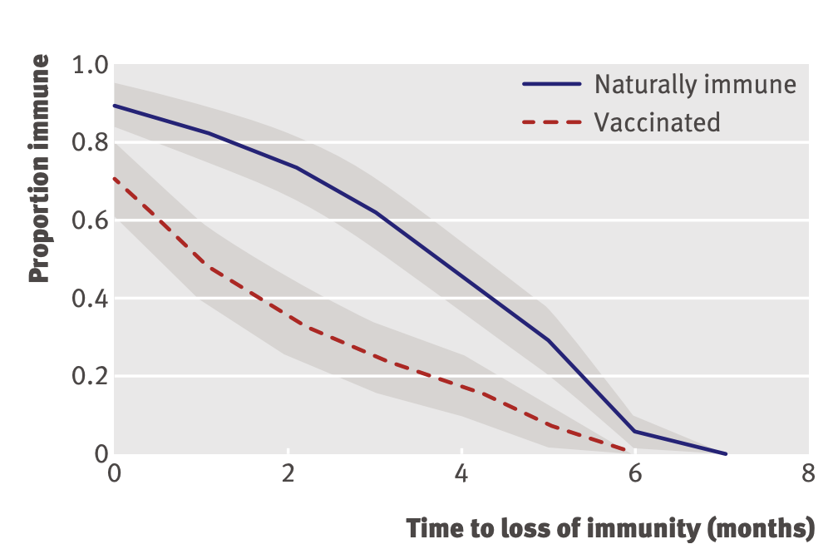
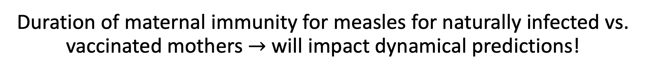
Duration of maternal immunity for measles for naturally infected vs. vaccinated mothers $→$ will impact dynamical predictions!
incorporating maternal immunity
Leuridan et al. 2010. BMJ.

Slide 8
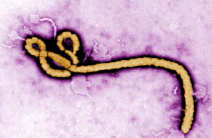
Pathogens exhibit diverse transmission mechanisms that require tailored modeling structures
Directly-transmitted diseases are transmitted via exchange of bodily fluids
Droplet (> 5 microns ) spread or direct contact
Includes sexually-transmitted pathogens, though often modeled with a more complex contact network
Smallpox (Variola spp.), HIV, Mononucleosis (Epstein Barr virus)
Indirectly-transmitted diseases are transmitted via droplets retained in air
Droplets < 5 microns in diameter
Measles, COVID (SARS-CoV-2)
μ
μ
μ
b
β
γ
S
I
R

Slide 9
Pathogens exhibit diverse transmission mechanisms that require tailored modeling structures
Environmentally-transmitted pathogens are transmitted outside of the host (e.g. water-borne, food-borne)
Examples: Cholera (Vibrio cholerae), Salmonellosis (Salmonella spp. bacteria), White-Nosed Syndrome (Pseudogymnoascus destructans)

Slide 10
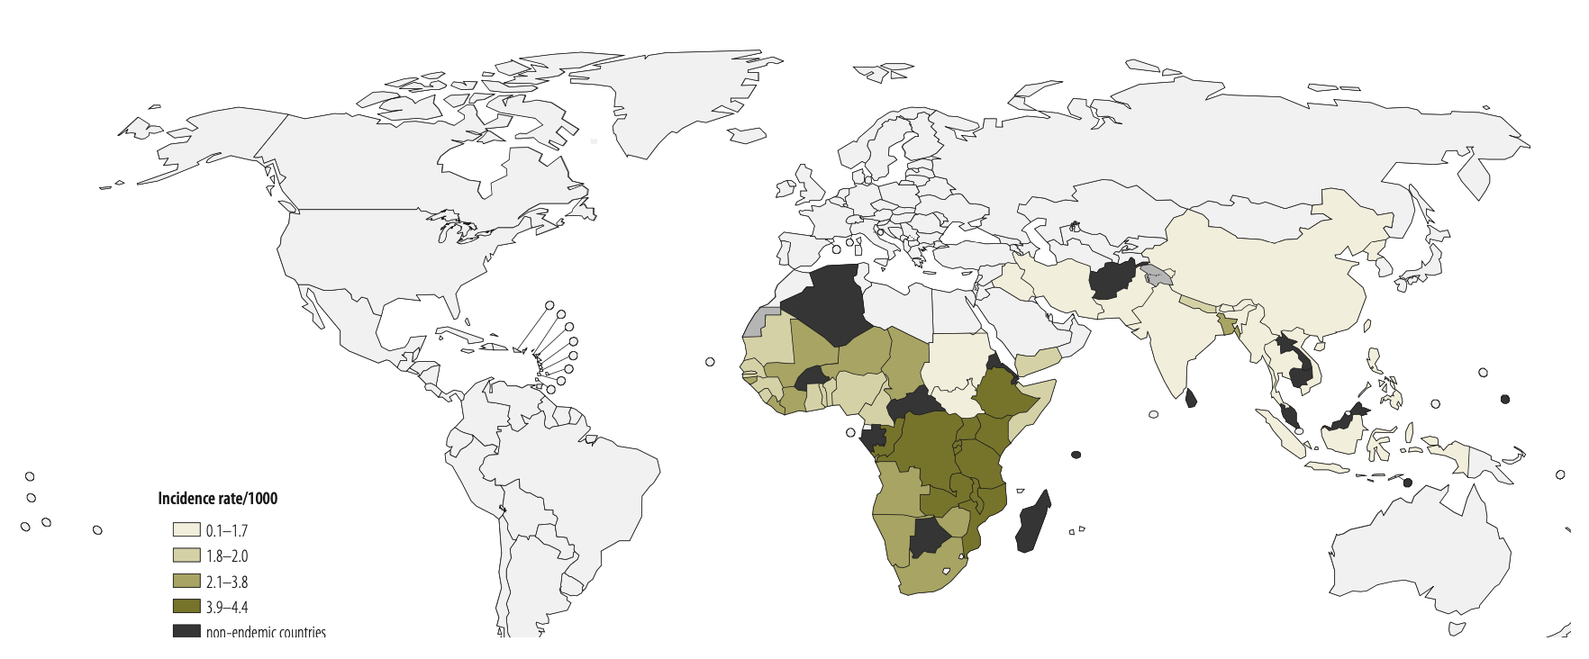
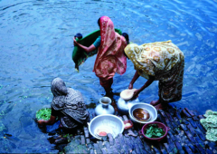
Pathogens exhibit diverse transmission mechanisms that require tailored modeling structures
Environmentally-transmitted pathogens are transmitted outside of the host (e.g. water-borne, food-borne)
Examples: Cholera (Vibrio cholerae), Salmonellosis (Salmonella spp. bacteria), White-Nosed Syndrome (Pseudogymnoascus destructans)
Global Burden of Cholera, 2012
Estimated 2.8 million cases & 95,000 deaths annually
Ali et al. 2012. WHO Bulletin.

Slide 11
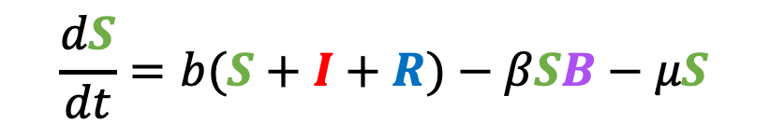
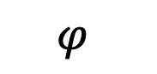
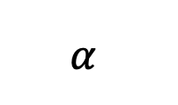
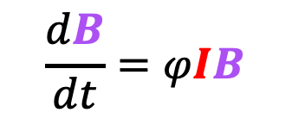
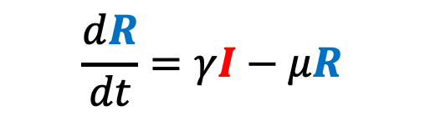
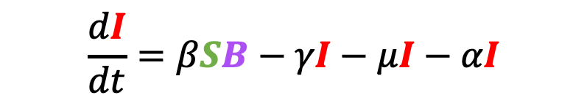
Pathogens exhibit diverse transmission mechanisms that require tailored modeling structures
Environmentally-transmitted pathogens are transmitted outside of the host (e.g. water-borne, food-borne)
Examples: Cholera (Vibrio cholerae), Salmonellosis (Salmonella spp. bacteria), White-Nosed Syndrome (Pseudogymnoascus destructans)
Here, the environmental reservoir is often modeled as its own population
μ
$$α$$
μ
μ
$$\frac{dB}{dt}=φIB$$
γ
b
β
S
I
R
$$\frac{dS}{dt}=b(S+I+R)−βSB−μS$$
$$\frac{dI}{dt}=βSB−γI−μI−αI$$
cholera environmental reservoir
$$φ$$
B
Bacteria
$$\frac{dR}{dt}=γI−μR$$
Codeço 2001. BMC Infectious Diseases.
Notes:
Kissing bugs = hemiptera = true bugs

Slide 12
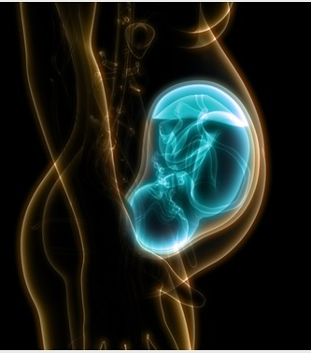
Pathogens exhibit diverse transmission mechanisms that require tailored modeling structures
Vertically-transmitted pathogens are transmitted mother-to-child in utero
Examples: HIV, Herpes simplex virus, Cytomegalovirus, Rubella, Zika

Slide 13
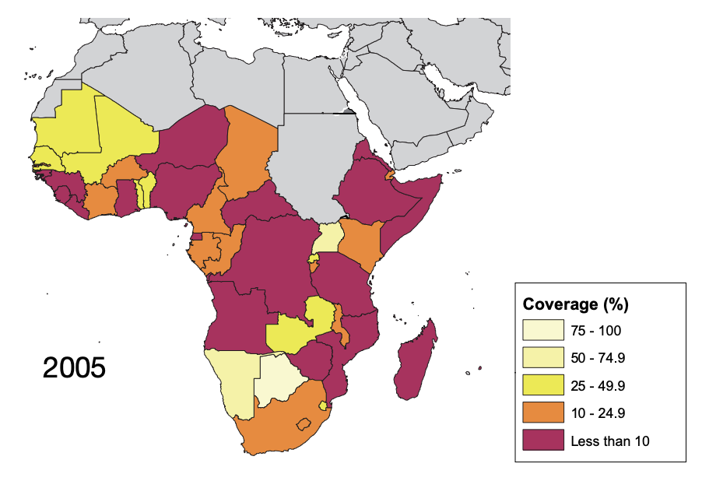
Pathogens exhibit diverse transmission mechanisms that require tailored modeling structures
Vertically-transmitted pathogens are transmitted mother-to-child in utero
Examples: HIV, Herpes simplex virus, Cytomegalovirus, Rubella, Zika
In untreated HIV+ mothers, rate of vertical transmission for HIV = 15-45%
Reduced to <1% for those on ART, though global access to ART is geographically heterogenous
ART coverage for those in need, from WHO 2005

Slide 14
Pathogens exhibit diverse transmission mechanisms that require tailored modeling structures
Vector-borne diseases (a type of indirect transmission) are transmitted via blood-feeding arthropod (mosquitoes, ticks, fleas)
Notes:
Kissing bugs = hemiptera = true bugs

Slide 15
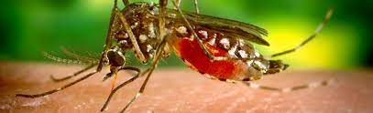
Pathogens exhibit diverse transmission mechanisms that require tailored modeling structures
Vector-borne diseases (a type of indirect transmission) are transmitted via blood-feeding arthropod (mosquitoes, ticks, fleas)
Euclidean vector: a quantity with a magnitude and direction
Epidemiological vector: an agent that carries and transmits an infectious patient into another living organism
Notes:
Kissing bugs = hemiptera = true bugs

Slide 16
Pathogens exhibit diverse transmission mechanisms that require tailored modeling structures
Vector-borne diseases (a type of indirect transmission) are transmitted via blood-feeding arthropod (mosquitoes, ticks, fleas)
Malaria: Mosquito-borne protozoan Plasmodium spp.
“Arboviruses”: Mosquito-borne viruses, including Dengue, Zika, Yellow fever virus, West Nile virus, Chikungunya virus
Sleeping sickness, also known as African trypanosomiasis: tsetse fly vector and protozoan pathogen (trypanosome)
Chagas disease: kissing bug vector and trypanosome pathogen
Plague: flea vector and bacterial pathogen (Yersinia pestis)
Notes:
Kissing bugs = hemiptera = true bugs

Slide 17
Pathogens exhibit diverse transmission mechanisms that require tailored modeling structures
Vector-borne diseases (a type of indirect transmission) are transmitted via blood-feeding arthropod (mosquitoes, ticks, fleas)
Malaria: Mosquito-borne protozoan Plasmodium spp.
“Arboviruses”: Mosquito-borne viruses, including Dengue, Zika, Yellow fever virus, West Nile virus, Chikungunya virus
Sleeping sickness, also known as African trypanosomiasis: tsetse fly vector and protozoan pathogen (trypanosome)
Chagas disease: kissing bug vector and trypanosome pathogen
Plague: flea vector and bacterial pathogen (Yersinia pestis)
Notes:
Kissing bugs = hemiptera = true bugs

Slide 18
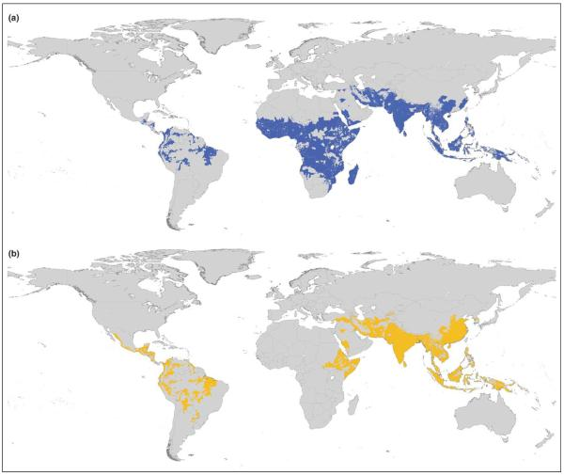
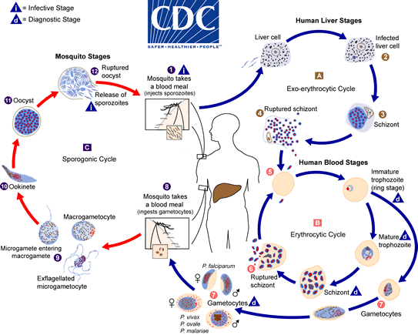
Malaria
4 main human Plasmodium parasites (falciparum, vivax, malariae, ovalae).
Over 200 Plasmodium spp. globally, infecting birds, reptiles, and other mammals (rodents, bats, primates)
Distribution Plasmodium falciparum
Distribution Plasmodium vivax
Guerra et al. 2006. Trends in Parasitology

Slide 19
Malaria
4 main human Plasmodium parasites (falciparum, vivax, malariae, ovalae).
Over 200 Plasmodium spp. globally, infecting birds, reptiles, and other mammals (rodents, bats, primates)
Distribution Plasmodium falciparum
Distribution Plasmodium vivax
Plasmodium parasites time RBC bursting such that they are at peak blood stage circulation when mosquito vectors are feeding at dusk!
Guerra et al. 2006. Trends in Parasitology

Slide 20
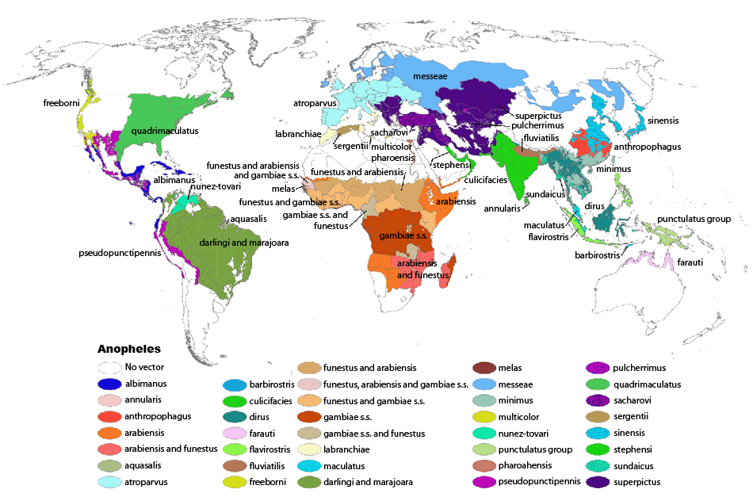
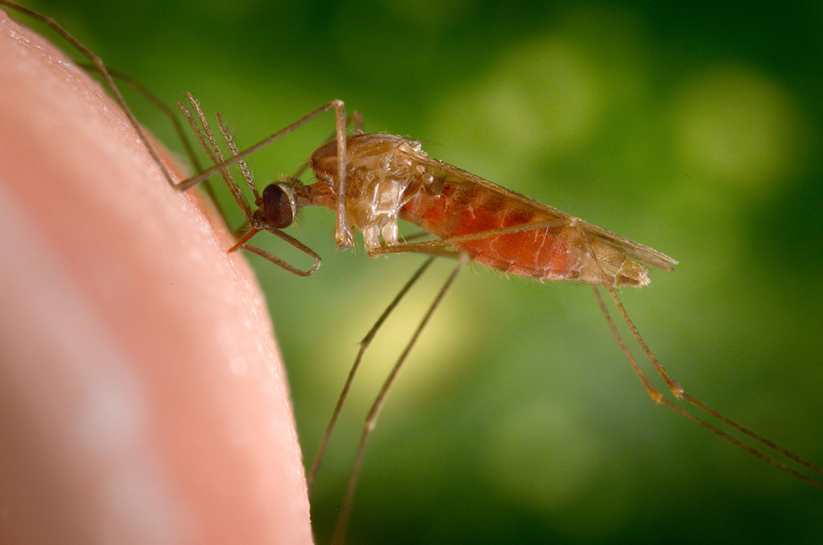
Malaria
4 main human Plasmodium parasites (falciparum, vivax, malariae, ovalae).
Over 200 Plasmodium spp. globally, infecting birds, reptiles, and other mammals (rodents, bats, primates)
>400 global species of Anopheles mosquito, >100 that can transmit human malaria
~30-40 Anopheles spp. most commonly implicated in human malaria transmission!
Kiszewksi et al. 2004. ASTMH.

Slide 21
Malaria
4 main human Plasmodium parasites (falciparum, vivax, malariae, ovalae).
Over 200 Plasmodium spp. globally, infecting birds, reptiles, and other mammals (rodents, bats, primates)
>400 global species of Anopheles mosquito, >100 that can transmit human malaria
~30-40 Anopheles spp. most commonly implicated in human malaria transmission!
Only female mosquitoes feed on blood!
Male mosquitoes feed on plant nectar.
Kiszewksi et al. 2004. ASTMH.

Slide 22
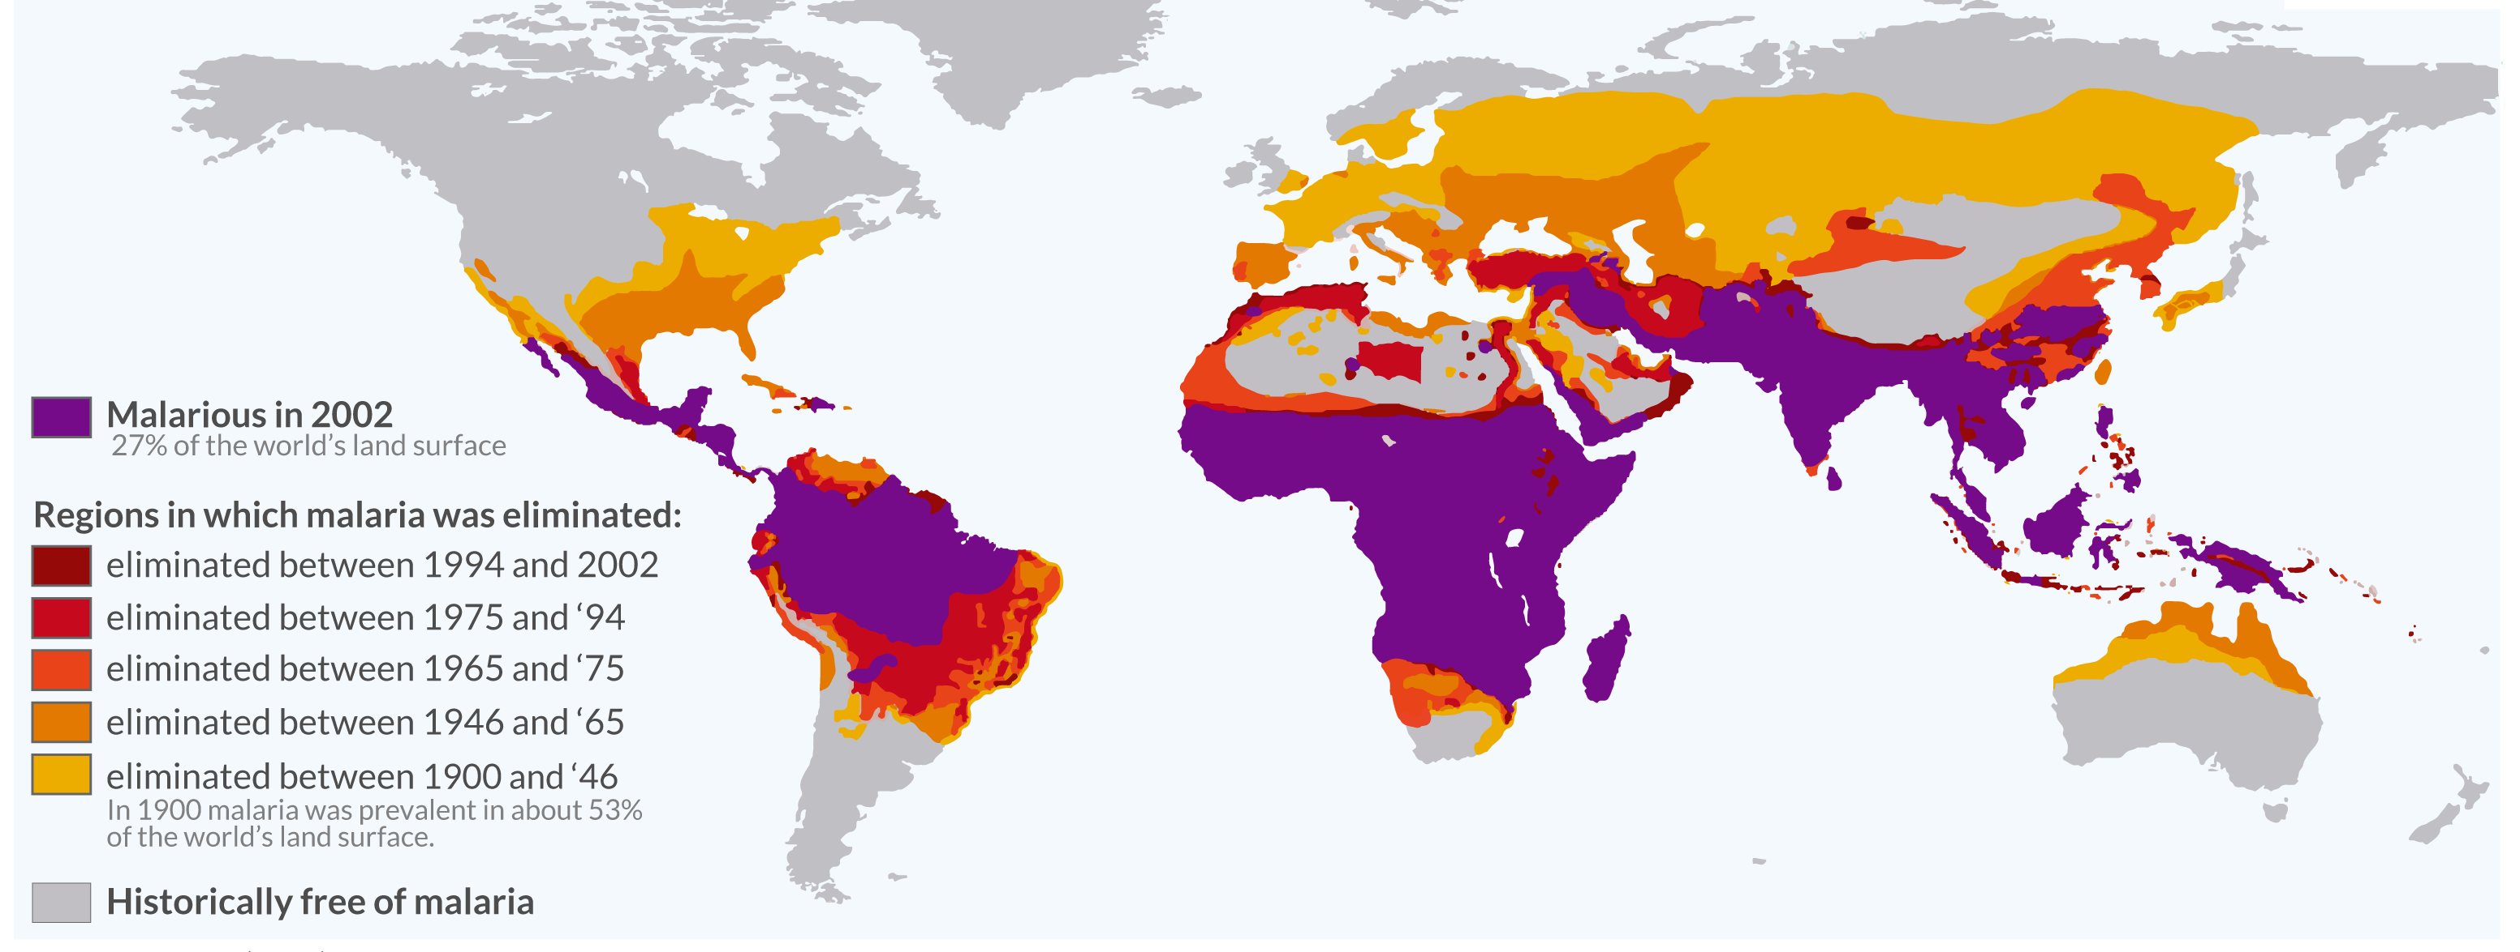
Malaria has been eliminated from many regions where it was previously endemic, including the US.
Still one of the leading causes of child mortality globally – responsible for about half a million childhood deaths a year, 80% in Africa.
OurWorldinData.org

Slide 23

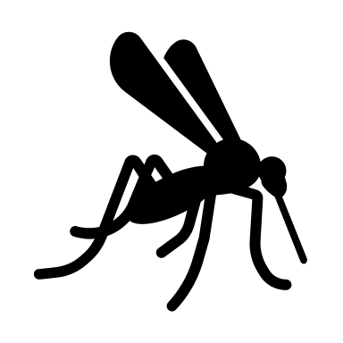
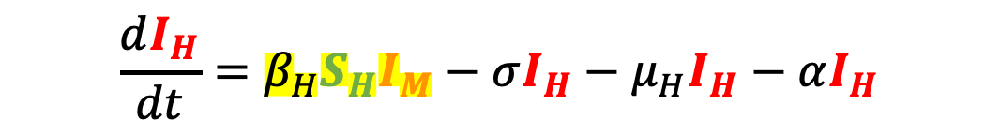
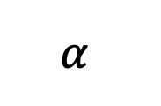
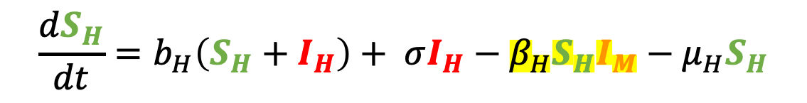

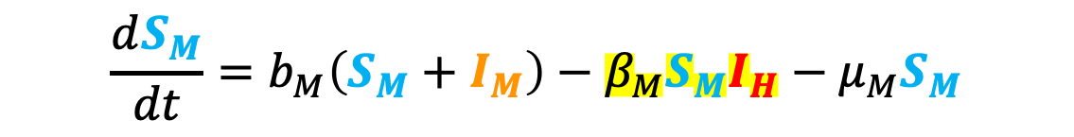
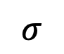
Malaria models have played a critical role in public health policy for over a century.
$$σ$$
1911: British medical Dr. Sir Ronald Ross developed the first model of malaria while working in the Indian Medical Service.
He had already won the 1902 Nobel prize in physiology and medicine for discovering the life cycle of avian malaria
μ_{H}
μ_{H}
b_{H}
β_{H}
$$α$$
S_{H}
I_{H}
$$\frac{dS_{H}}{dt}=b_{H}\left(S_{H}+I_{H}\right)+ σI_{H}−β_{H}S_{H}I_{M}−μ_{H}S_{H}$$
b_{M}
S_{M}
β_{M}
I_{M}
$$\frac{dI_{H}}{dt}=β_{H}S_{H}I_{M}−σI_{H}−μ_{H}I_{H}−αI_{H}$$
μ_{M}
μ_{M}
$$\frac{dS_{M}}{dt}=b_{M}\left(S_{M}+I_{M}\right)−β_{M}S_{M}I_{H}−μ_{M}S_{M}$$
$$\frac{dI_{M}}{dt}=β_{M}S_{M}I_{H}−μ_{M}I_{M}$$

Slide 24

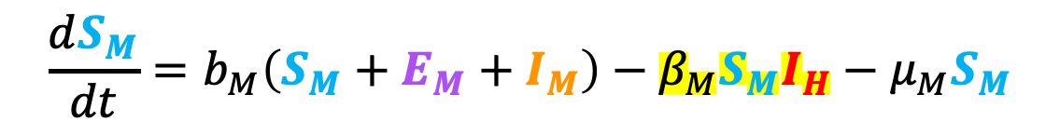
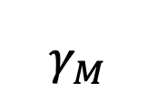

Malaria models have played a critical role in public health policy for over a century.
$$σ$$
1911: British medical Dr. Sir Ronald Ross developed the first model of malaria while working in the Indian Medical Service.
1957: MacDonald modified this model to include the latent period of the parasite developing in the mosquito.
He implicated the survivorship of the female mosquito as the weakest link in the life cycle!
μ_{H}
μ_{H}
b_{H}
β_{H}
$$α$$
S_{H}
I_{H}
b_{M}
β_{M}
$$γ_{M}$$
S_{M}
E_{M}
I_{M}
$$\frac{dS_{M}}{dt}=b_{M}\left(S_{M}+E_{M}+I_{M}\right)−β_{M}S_{M}I_{H}−μ_{M}S_{M}$$
μ_{M}
μ_{M}
μ_{M}
$$\frac{dE_{M}}{dt}=β_{M}S_{M}I_{H}−μ_{M}E_{M}−γ_{M}E_{M}$$
$$\frac{dI_{M}}{dt}=γ_{M}E_{M}−μ_{M}I_{M}$$

Slide 25
Malaria models have played a critical role in public health policy for over a century.
$$σ$$
1911: British medical Dr. Sir Ronald Ross developed the first model of malaria while working in the Indian Medical Service.
1957: MacDonald modified this model to include the latent period of the parasite developing in the mosquito.
This led to a widespread WHO campaign for malaria elimination using DDT in the 1950s!
Swiss chemist Paul Müller awarded 1948 Nobel Prize in medicine and physiology for discovering DDT and its impacts on arthropods
DDT played a major role in eliminating malaria from Europe and North America
DDT bioaccumulates and is carcinogenic – led to development of an environmental backlash in the US, culminating in Rachel Carson’s 1962 book Silent Spring
DDT banned globally in 2004, excepting in cases of WHO-recommended indoor residual spraying (IRS) for vector control in malaria-endemic regions
μ_{H}
μ_{H}
b_{H}
β_{H}
$$α$$
S_{H}
I_{H}
b_{M}
β_{M}
$$γ_{M}$$
S_{M}
E_{M}
I_{M}
μ_{M}
μ_{M}
μ_{M}

Slide 26
Malaria models have played a critical role in public health policy for over a century.
$$σ$$
1911: British medical Dr. Sir Ronald Ross developed the first model of malaria while working in the Indian Medical Service.
1957: MacDonald modified this model to include the latent period of the parasite developing in the mosquito.
This led to a widespread WHO campaign for malaria elimination using DDT in the 1950s!
Swiss chemist Paul Müller awarded 1948 Nobel Prize in medicine and physiology for discovering DDT and its impacts on arthropods
DDT played a major role in eliminating malaria from Europe and North America
DDT bioaccumulates and is carcinogenic – led to development of an environmental backlash in the US, culminating in Rachel Carson’s 1962 book Silent Spring
DDT banned globally in 2004, excepting in cases of WHO-recommended indoor residual spraying (IRS) for vector control in malaria-endemic regions
μ_{H}
μ_{H}
b_{H}
β_{H}
$$α$$
S_{H}
I_{H}
b_{M}
β_{M}
$$γ_{M}$$
S_{M}
E_{M}
I_{M}
μ_{M}
μ_{M}
μ_{M}

Slide 27
Malaria models have played a critical role in public health policy for over a century.
$$σ$$
1911: British medical Dr. Sir Ronald Ross developed the first model of malaria while working in the Indian Medical Service.
1957: MacDonald modified this model to include the latent period of the parasite developing in the mosquito.
This led to a widespread WHO campaign for malaria elimination using DDT in the 1950s!
Swiss chemist Paul Müller awarded 1948 Nobel Prize in medicine and physiology for discovering DDT and its impacts on arthropods
DDT played a major role in eliminating malaria from Europe and North America
DDT bioaccumulates and is carcinogenic – led to development of an environmental backlash in the US, culminating in Rachel Carson’s 1962 book Silent Spring
DDT banned globally in 2004, excepting in cases of WHO-recommended indoor residual spraying (IRS) for vector control in malaria-endemic regions
μ_{H}
μ_{H}
b_{H}
β_{H}
$$α$$
S_{H}
I_{H}
b_{M}
β_{M}
$$γ_{M}$$
S_{M}
E_{M}
I_{M}
μ_{M}
μ_{M}
μ_{M}

Slide 28
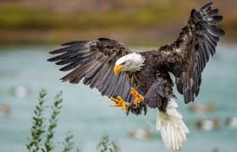
Malaria models have played a critical role in public health policy for over a century.
1911: British medical Dr. Sir Ronald Ross developed the first model of malaria while working in the Indian Medical Service.
1957: MacDonald modified this model to include the latent period of the parasite developing in the mosquito.
This led to a widespread WHO campaign for malaria elimination using DDT in the 1950s!
Swiss chemist Paul Müller awarded 1948 Nobel Prize in medicine and physiology for discovering DDT and its impacts on arthropods
DDT played a major role in eliminating malaria from Europe and North America
DDT bioaccumulates and is carcinogenic – led to development of an environmental backlash in the US, culminating in Rachel Carson’s 1962 book Silent Spring
DDT banned globally in 2004, excepting in cases of WHO-recommended indoor residual spraying (IRS) for vector control in malaria-endemic regions
Bioaccumulation:
the gradual accumulation of substances in an organism through time; particularly dangerous for high trophic level consumers

Slide 29
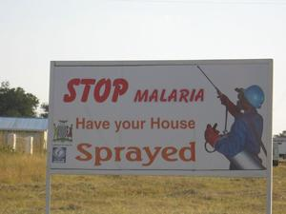
Malaria models have played a critical role in public health policy for over a century.
1911: British medical Dr. Sir Ronald Ross developed the first model of malaria while working in the Indian Medical Service.
1957: MacDonald modified this model to include the latent period of the parasite developing in the mosquito.
This led to a widespread WHO campaign for malaria elimination using DDT in the 1950s!
Swiss chemist Paul Müller awarded 1948 Nobel Prize in medicine and physiology for discovering DDT and its impacts on arthropods
DDT played a major role in eliminating malaria from Europe and North America
DDT bioaccumulates and is carcinogenic – led to development of an environmental backlash in the US, culminating in Rachel Carson’s 1962 book Silent Spring
DDT banned globally in 2004, excepting in cases of WHO-recommended indoor residual spraying (IRS) for vector control in malaria-endemic regions

Slide 30
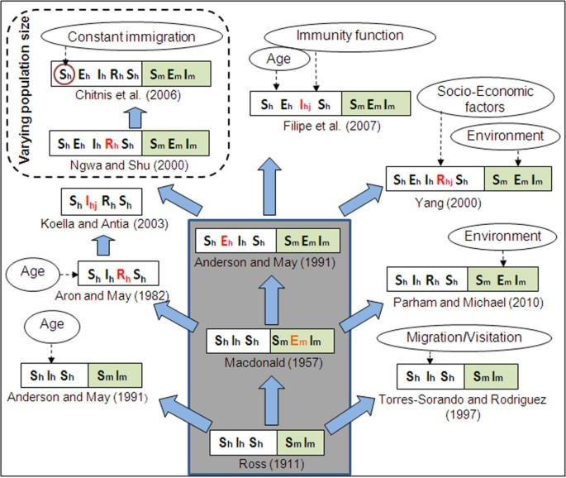
Malaria models have played a critical role in public health policy for over a century.
1911: British medical Dr. Sir Ronald Ross developed the first model of malaria while working in the Indian Medical Service.
1957: MacDonald modified this model to include the latent period of the parasite in the mosquito.
This led to a widespread WHO campaign for malaria elimination using DDT in the 1950s!
1991: Anderson and May extended model to show latency in the human population.
Mandal et al. 2011. Malaria Journal.

Slide 31
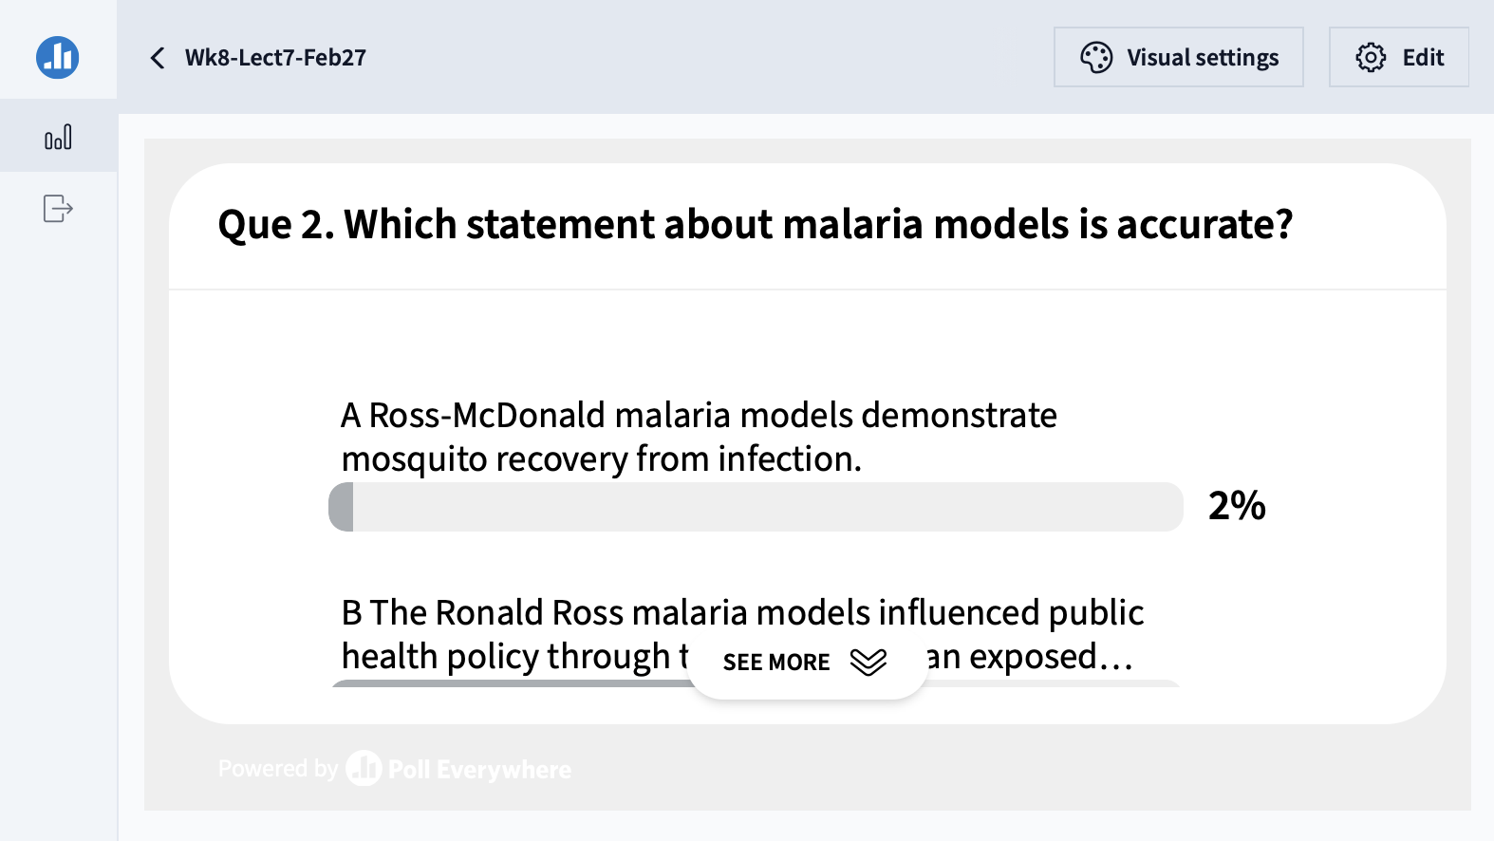

Slide 32
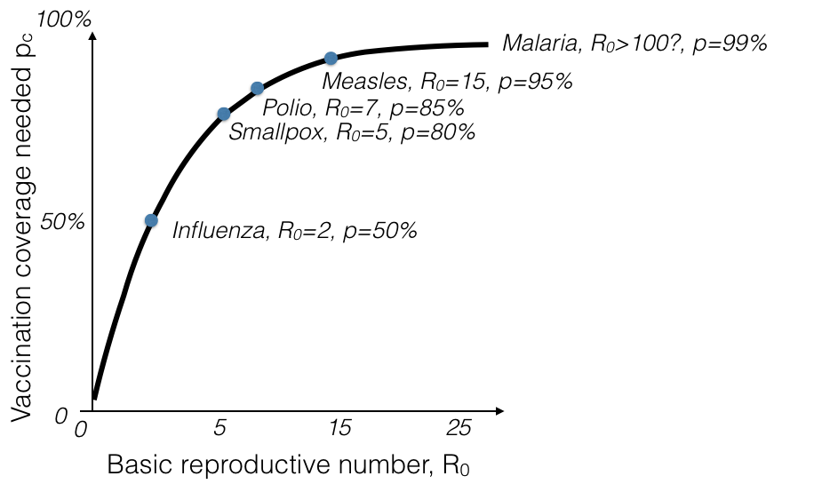
Challenges to malaria elimination
High parasite diversity: sexual reproduction in 4+ Plasmodium species
Fast evolution of resistance (e.g. to drugs)
Many possible vectors! Potentially additional possible reservoirs!
Latent cases as burden is reduced
Vaccine candidates: what life stage to target?
Herd immunity threshold (HIT)

Slide 33
Challenges to malaria elimination
High parasite diversity: sexual reproduction in 4+ Plasmodium species
Fast evolution of resistance (e.g. to drugs)
Many possible vectors! Potentially additional possible reservoirs!
Latent cases as burden is reduced
Vaccine candidates: what life stage to target?
Herd immunity threshold (HIT)

Slide 34
Challenges to malaria elimination
High parasite diversity: sexual reproduction in 4+ Plasmodium species
Fast evolution of resistance (e.g. to drugs)
Many possible vectors! Potentially additional possible reservoirs!
Latent cases as burden is reduced
Vaccine candidates: what life stage to target?
Herd immunity threshold (HIT)

Slide 35
Challenges to malaria elimination
High parasite diversity: sexual reproduction in 4+ Plasmodium species
Fast evolution of resistance (e.g. to drugs)
Many possible vectors! Potentially additional possible reservoirs!
Latent cases as burden is reduced
Vaccine candidates: what life stage to target?
Herd immunity threshold (HIT)

Slide 36
Challenges to malaria elimination
High parasite diversity: sexual reproduction in 4+ Plasmodium species
Fast evolution of resistance (e.g. to drugs)
Many possible vectors! Potentially additional possible reservoirs!
Latent cases as burden is reduced
Vaccine candidates: what life stage to target?
Herd immunity threshold (HIT)

Slide 37
Pathogens exhibit diverse transmission mechanisms that require tailored modeling structures
Vector-borne diseases (a type of indirect transmission) are transmitted via blood-feeding arthropod (mosquitoes, ticks, fleas)
Malaria: Mosquito-borne protozoan Plasmodium spp.
“Arboviruses”: Mosquito-borne viruses, including Dengue, Zika, Yellow fever virus, West Nile virus, Chikungunya virus
Sleeping sickness, also known as African trypanosomiasis: tsetse fly vector and protozoan pathogen (trypanosome)
Chagas disease: kissing bug vector and trypanosome pathogen
Plague: flea vector and bacterial pathogen (Yersinia pestis)
Notes:
Kissing bugs = hemiptera = true bugs

Slide 38
Pathogens exhibit diverse transmission mechanisms that require tailored modeling structures
Vector-borne diseases (a type of indirect transmission) are transmitted via blood-feeding arthropod (mosquitoes, ticks, fleas)
Malaria: Mosquito-borne protozoan Plasmodium spp.
“Arboviruses”: Mosquito-borne viruses, including Dengue, Zika, Yellow fever virus, West Nile virus, Chikungunya virus
Sleeping sickness, also known as African trypanosomiasis: tsetse fly vector and protozoan pathogen (trypanosome)
Chagas disease: kissing bug vector and trypanosome pathogen
Plague: flea vector and bacterial pathogen (Yersinia pestis)
Plague is BOTH vector-borne and zoonotic!
Notes:
Kissing bugs = hemiptera = true bugs

Slide 39
A pathogen reservoir sources infections to a target population.
reservoir population
target population
Haydon et al. 2002. Emerging Infectious Diseases.

Slide 40
A pathogen reservoir sources infections to a target population.
reservoir population
target population
All of these populations are still called hosts!
Some are reservoir hosts and some are spillover hosts.
Haydon et al. 2002. Emerging Infectious Diseases.

Slide 41
Reservoir hosts can comprise a single species population or multiple sub-populations of different species.
maintenance
population
(> critical community size, CCS)
target population
non-maintenance population
(< CCS)
reservoir population
Haydon et al. 2002. Emerging Infectious Diseases.

Slide 42
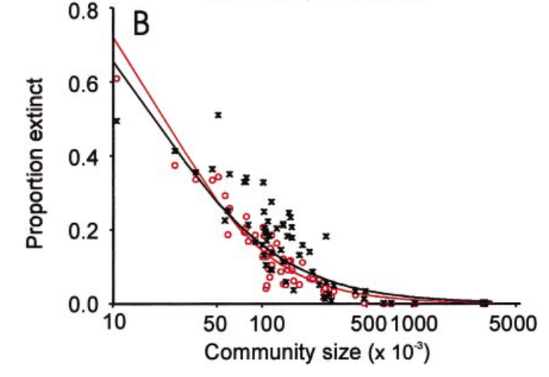
CCS is the minimum number of hosts needed to sustain endemic transmission of a pathogen indefinitely into the future.
CCS for measles = ~300,000 individuals
maintenance
population
(> critical community size, CCS)
Bartlett 1957. J of Roy Stat Soc.
Grenfell et al. 2002. Ecological Monographs.
Haydon et al. 2002. Emerging Infectious Diseases.

Slide 43
Spillover is the transmission of that pathogen between populations of different host species.
maintenance
population
(> CCS)
target population
non-maintenance population
(< CCS)
reservoir population
Haydon et al. 2002. Emerging Infectious Diseases.

Slide 44
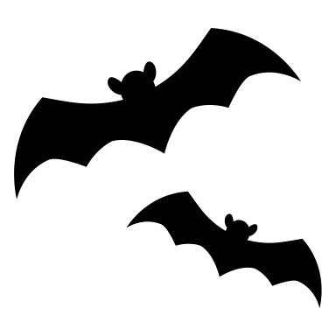
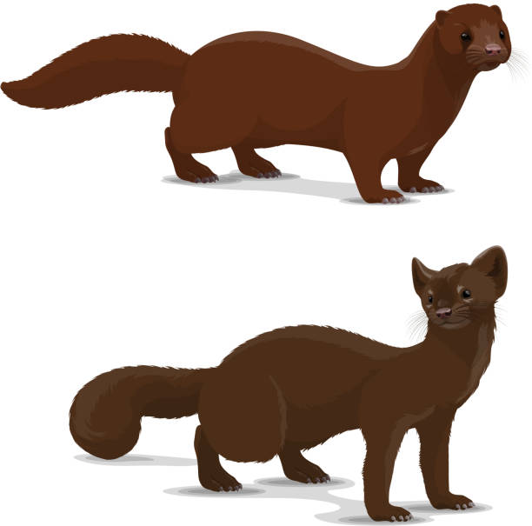
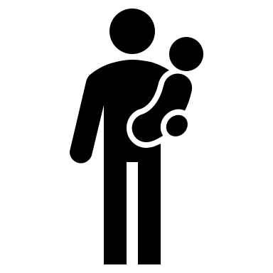
Spillback is the term used to describe pathogen transmission back to a reservoir host from a target host.
maintenance
population
(> CCS)
target population
maintenance
population
(> CCS)
example: SARS-CoV-2 in mink – interesting case because neither humans nor mink are the original reservoir host!
reservoir population
Haydon et al. 2002. Emerging Infectious Diseases.

Slide 45


Spillback occurs among wildlife as well.
maintenance
population
(> CCS)
target population
reservoir population
example: Cattle sourced Brucella to wild ungulates in Yellowstone National Park, which now serve as a source for reinfection to cattle.
Haydon et al. 2002. Emerging Infectious Diseases.

Slide 46
Zoonosis is the transmission of a pathogen from a wildlife reservoir host to a human target host population.
maintenance
population
(> critical community size, CCS)
human population
non-maintenance population
(< CCS)
reservoir population
Haydon et al. 2002. Emerging Infectious Diseases.

Slide 47
Zoonosis is the transmission of a pathogen from a wildlife reservoir host to a human target host population.
maintenance
population
(> critical community size, CCS)
human population
non-maintenance population
(< CCS)
Can occur directly (e.g. SARS-CoV-2, rabies), or via vector (e.g. plague)
Animal hosts are not vectors!
reservoir population
Haydon et al. 2002. Emerging Infectious Diseases.

Slide 48


Zoonosis is the transmission of a pathogen from a wildlife reservoir host to a human target host population.
maintenance
population
(> CCS)
human population
non-maintenance population
(< CCS)
example: rabies
reservoir population
Lembo et al. 2008. Journal of Animal Ecology
Haydon et al. 2002. Emerging Infectious Diseases.

Slide 49
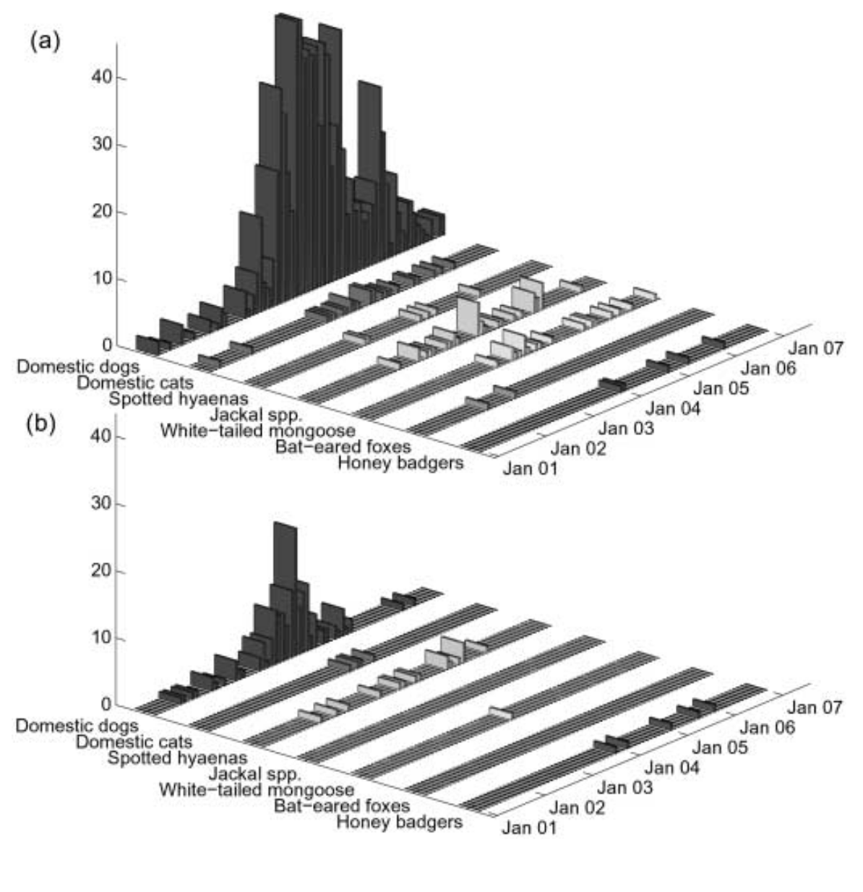
Rabies in the Serengeti is maintained in domestic dogs but can spillover to wild African carnivores.
Serengeti District, Tanzania
Cases of Rabies
Cases of Rabies
Ngorogoro District, Tanzania
Lembo et al. 2008. Journal of Animal Ecology

Slide 50
Understanding processes which maintain zoonoses in reservoirs can guide interventions to reduce spillover to humans.
maintenance
population
(> CCS)
human population
non-maintenance population
(< CCS)
reservoir population
Lembo et al. 2008. Journal of Animal Ecology
Haydon et al. 2002. Emerging Infectious Diseases.

Slide 51
Understanding processes which maintain zoonoses in reservoirs can guide interventions to reduce spillover to humans.
vaccination
maintenance
population
(> CCS)
human population
non-maintenance population
(< CCS)
reservoir population
Lembo et al. 2008. Journal of Animal Ecology
Haydon et al. 2002. Emerging Infectious Diseases.

Slide 52
Understanding processes which maintain zoonoses in reservoirs can guide interventions to reduce spillover to humans.
non-maintenance
population
(< CCS)
human population
non-maintenance population
(< CCS)
reservoir population
Lembo et al. 2008. Journal of Animal Ecology
Haydon et al. 2002. Emerging Infectious Diseases.

Slide 53
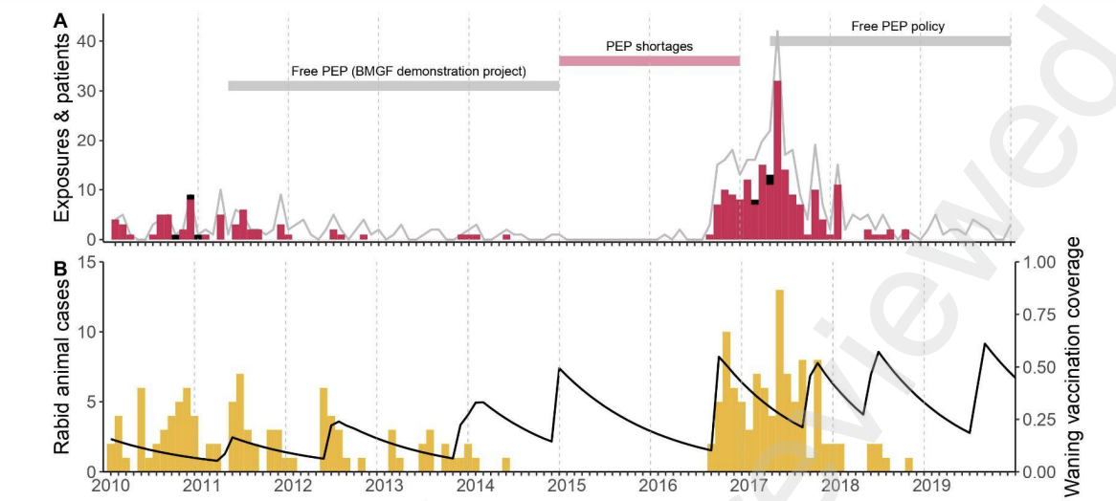
Vaccination of domestic dogs can successfully eradicate rabies from some systems.
dog cases
dog vaccination coverage
Lushasi et al. 2023. eLife.

Slide 54
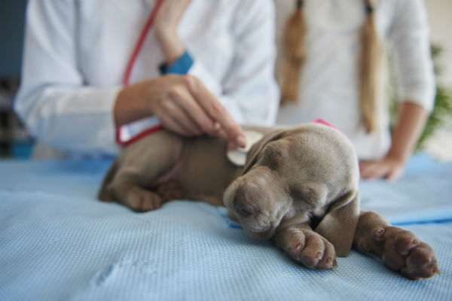
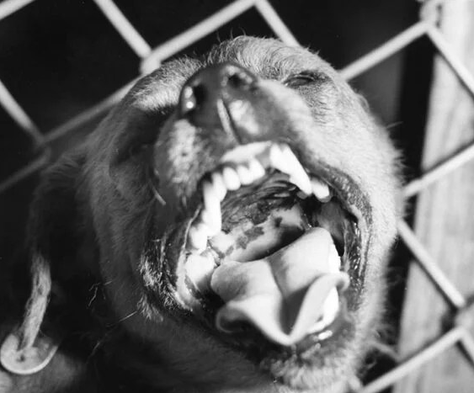
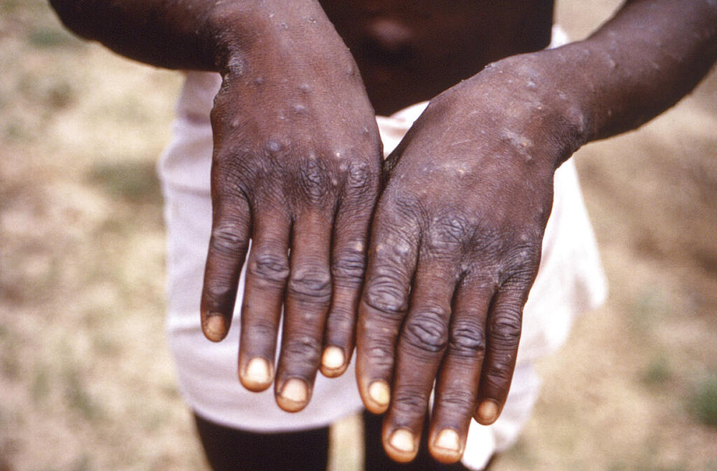
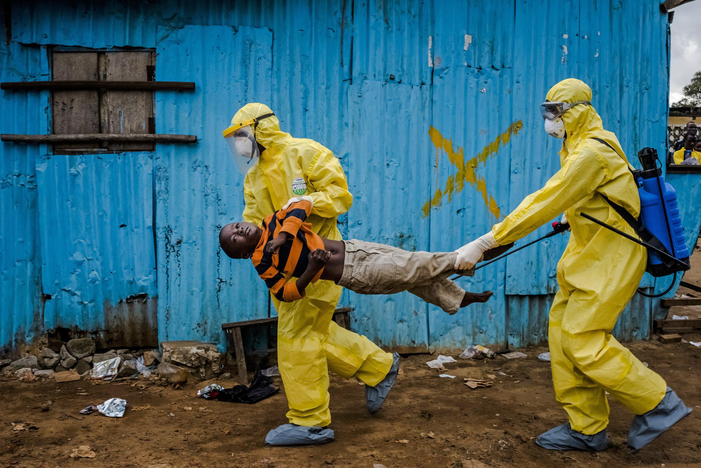
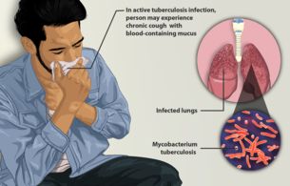
Pathogens can be classed according to their host relationships.
Stage I
Stage II
Stage III
Stage IV
Stage V
Transmits exclusively in humans
Transmits exclusively in animals
Human cases from spillovers only
Stuttering chains of transmission in humans
Sustained transmission and human outbreaks
canine parvovirus
rabies virus
monkeypox (pre-2022)
Ebola virus (especially post-2014)
Tuberculosis
Lloyd-Smith et al. 2009. Science.

Slide 55
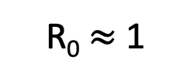
Pathogens can be classed according to their host relationships.
Stage I
Stage II
Stage III
Stage IV
Stage V
Transmits exclusively in humans
Transmits exclusively in animals
Human cases from spillovers only
Stuttering chains of transmission in humans
Sustained transmission and human outbreaks
canine parvovirus
rabies virus
monkeypox (pre-2022)
Ebola virus (especially post-2014)
Tuberculosis
R₀ < 1
R₀ $≈$ 1
R₀ > 1
Zoonotic pathogens can be classed according to their R₀ in humans.
Lloyd-Smith et al. 2009. Science.

Slide 56



Most stage V pathogens once had an animal origin, as well!
Stage V
Transmits exclusively in humans
HIV
Sharp & Hahn. 2011. Cold Spring Harb Perspect Med.

Slide 57

The force of infection (FOI), $λ$, is the rate at which susceptibles become infected
For a single host pathogen: ${λ=R}_{0}\frac{I}{N}$
(FOI = R₀ * proportion infected)
$≈$ mirror image of${ R}_{E}{=R}_{0}\frac{S}{N}$
Also a finger on the epidemic pulse
For multi-host pathogens, we can define the spillover force of infection
Comprised of:
Infectiousness of the reservoir
Reservoir-human contact rates
Susceptibility in the human host
Lloyd-Smith et al. 2009. Science.

Slide 58
The force of infection (FOI), $λ$, is the rate at which susceptibles become infected
For a single host pathogen: ${λ=R}_{0}\frac{I}{N}$
(FOI = R₀ * proportion infected)
$≈$ mirror image of${ R}_{E}{=R}_{0}\frac{S}{N}$
Also a finger on the epidemic pulse
For multi-host pathogens, we can define the spillover force of infection
Comprised of:
Infectiousness of the reservoir
Reservoir-human contact rates
Susceptibility in the human host
Lloyd-Smith et al. 2009. Science.

Slide 59
The force of infection (FOI), $λ$, is the rate at which susceptibles become infected
For a single host pathogen: ${λ=R}_{0}\frac{I}{N}$
(FOI = R₀ * proportion infected)
$≈$ mirror image of${ R}_{E}{=R}_{0}\frac{S}{N}$
Also a finger on the epidemic pulse
For multi-host pathogens, we can define the spillover force of infection
Comprised of:
Infectiousness of the reservoir
Reservoir-human contact rates
Susceptibility in the human host
Lloyd-Smith et al. 2009. Science.

Slide 60
The force of infection (FOI), $λ$, is the rate at which susceptibles become infected
For a single host pathogen: ${λ=R}_{0}\frac{I}{N}$
(FOI = R₀ * proportion infected)
$≈$ mirror image of${ R}_{E}{=R}_{0}\frac{S}{N}$
Also a finger on the epidemic pulse
For multi-host pathogens, we can define the spillover force of infection
Comprised of:
Infectiousness of the reservoir
Reservoir-human contact rates
Susceptibility in the human host
Lloyd-Smith et al. 2009. Science.

Slide 61
The force of infection (FOI), $λ$, is the rate at which susceptibles become infected
For a single host pathogen: ${λ=R}_{0}\frac{I}{N}$
(FOI = R₀ * proportion infected)
$≈$ mirror image of${ R}_{E}{=R}_{0}\frac{S}{N}$
Also a finger on the epidemic pulse
For multi-host pathogens, we can define the spillover force of infection
Comprised of:
Infectiousness of the reservoir
Reservoir-human contact rates
Susceptibility in the human host
Keeling & Gilligan model $λ_{H}$ for plague as proportional to the abundance of free-living infected fleas.
Lloyd-Smith et al. 2009. Science.

Slide 62

Fleas get infected from rats.
Humans get infected from free-living infected fleas!
“…from April 18 onwards, quantities of dead or dying rats were found in factories and warehouses…From the outer suburbs to the center of the town, in all the byways where the doctor's duties took him, in every thoroughfare, rats were piled up in garbage cans or lying in long lines in the gutters…On the fourth day the rats began to come out and die in batches…”
--La Peste, Albert Camus (1948)
Plague is BOTH vector-borne and zoonotic!
Keeling and Gilligan. 2000. Nature.

Slide 63
Humans get infected from free-living infected fleas!
“…from April 18 onwards, quantities of dead or dying rats were found in factories and warehouses…From the outer suburbs to the center of the town, in all the byways where the doctor's duties took him, in every thoroughfare, rats were piled up in garbage cans or lying in long lines in the gutters…On the fourth day the rats began to come out and die in batches…”
--La Peste, Albert Camus (1948)
Plague is BOTH vector-borne and zoonotic!
Keeling and Gilligan. 2000. Nature.

Slide 64

Zoonosis is a series of improbable events.
Plowright et al. 2017. Nature Reviews Microbiology.

Slide 65

Bottlenecks to spillover.
Plowright et al. 2017. Nature Reviews Microbiology.

Slide 66



When is influenza zoonotic?
Parry et al. 2020. Viruses.
Transmits exclusively in humans
Stage V
Influenza
Skelton & Huber. 2022. Viruses.

Slide 67
Why do pathogens make us sick?

Slide 68



Why do pathogens make us sick?
A virus will evolve to maximize its capacity for between-host infections (R₀).
Alizon et al. 2008. J Evolutionary Biology
Anderson and May 1982. Parasitology.
Notes:
Typically, we predict that a virus will evolve traits that maximize its capacity for reproducing itself by infecting new hosts, achieving a baseline viral density within a single individual that produces sufficient virions in excretia – like the cough shown here – to go on to infect new hosts

Slide 69

Why do pathogens make us sick?
A virus will evolve to maximize its capacity for between-host infections (R₀).
$$β$$
transmission
Alizon et al. 2008. J Evolutionary Biology
Anderson and May 1982. Parasitology.
Notes:
Typically, we predict that a virus will evolve traits that maximize its capacity for reproducing itself by infecting new hosts, achieving a baseline viral density within a single individual that produces sufficient virions in excretia – like the cough shown here – to go on to infect new hosts

Slide 70
Why do pathogens make us sick?
A virus will evolve to maximize its capacity for between-host infections (R₀).
$$α$$
virulence
$$β$$
transmission
Mechanisms that promote transmission may also enhance virulence to the host.
Alizon et al. 2008. J Evolutionary Biology
Anderson and May 1982. Parasitology.
Notes:
Typically, we predict that a virus will evolve traits that maximize its capacity for reproducing itself by infecting new hosts, achieving a baseline viral density within a single individual that produces sufficient virions in excretia – like the cough shown here – to go on to infect new hosts

Slide 71
Why do pathogens make us sick?
A virus will evolve to maximize its capacity for between-host infections (R₀).
Virulence, then, is a by-product of a pathogen’s need to transmit for reproduction!
$$α$$
virulence
$$β$$
transmission
Mechanisms that promote transmission may also enhance virulence to the host.
Alizon et al. 2008. J Evolutionary Biology
Anderson and May 1982. Parasitology.
Notes:
Typically, we predict that a virus will evolve traits that maximize its capacity for reproducing itself by infecting new hosts, achieving a baseline viral density within a single individual that produces sufficient virions in excretia – like the cough shown here – to go on to infect new hosts

Slide 72

Why do pathogens make us sick?
A virus will evolve to maximize its capacity for between-host infections (R₀).
$$α$$
virulence
As a result, we predict the evolution of “optimal virulence.”
$$β$$
transmission
$β$, transmission
Mechanisms that promote transmission may also enhance virulence to the host.
$α$, virulence + $μ$, nat. mort.
infections created
$$R_{0}=\frac{β(virus density)}{γ+ μ+α(virus density)}$$
Alizon et al. 2008. J Evolutionary Biology
Anderson and May 1982. Parasitology.
infections lost
Notes:
Typically, we predict that a virus will evolve traits that maximize its capacity for reproducing itself by infecting new hosts, achieving a baseline viral density within a single individual that produces sufficient virions in excretia – like the cough shown here – to go on to infect new hosts

Slide 73
Why do pathogens make us sick?
A virus will evolve to maximize its capacity for between-host infections (R₀).
$$α$$
virulence
As a result, we predict the evolution of “optimal virulence.”
$$β$$
transmission
$β$, transmission
Note that originally Anderson and May (1982) represented this link to virus density as acting on the disease recovery rate, though it is now more commonly expressed as a function of virulence!
Mechanisms that promote transmission may also enhance virulence to the host.
$α$, virulence + $μ$, nat. mort.
infections created
$$R_{0}=\frac{β(virus density)}{γ+ μ+α(virus density)}$$
Alizon et al. 2008. J Evolutionary Biology
Anderson and May 1982. Parasitology.
infections lost
Notes:
Typically, we predict that a virus will evolve traits that maximize its capacity for reproducing itself by infecting new hosts, achieving a baseline viral density within a single individual that produces sufficient virions in excretia – like the cough shown here – to go on to infect new hosts

Slide 74

For zoonoses, virulence and transmission tradeoff to result in total death burden.
Guth et al. 2019. Phil Trans Roy Soc.
Guth et al. 2022. PNAS.
Notes:
Leading researchers to ask, are bats somehow special in their capacity as zoonotic hosts?

Slide 75
For zoonoses, virulence and transmission tradeoff to result in total death burden.
Guth et al. 2019. Phil Trans Roy Soc.
Guth et al. 2022. PNAS.
Notes:
Leading researchers to ask, are bats somehow special in their capacity as zoonotic hosts?

Slide 76


The virulence case study of rabbit Myxoma virus
1788: European rabbits brought to Australia as a food source
Rabbits quickly became feral and numbers soared.
1901: Australia constructed the famous “rabbit-proof fence” to attempt to keep rabbits out of agriculture in the West
Government looked to control measures, including biological controls in the 1930s.
Tried Myxoma virus, a highly virulent European poxvirus infecting rabbits. with a CFR >99%

Slide 77
The virulence case study of rabbit Myxoma virus
1788: European rabbits brought to Australia as a food source
Rabbits quickly became feral and numbers soared.
1901: Australia constructed the famous “rabbit-proof fence” to attempt to keep rabbits out of agriculture in the West.
Government looked to control measures, including biological controls in the 1930s.
Tried Myxoma virus, a highly virulent European poxvirus infecting rabbits. with a CFR >99%

Slide 78
The virulence case study of rabbit Myxoma virus
1788: European rabbits brought to Australia as a food source
Rabbits quickly became feral and numbers soared.
1901: Australia constructed the famous “rabbit-proof fence” to attempt to keep rabbits out of agriculture in the West.
Government looked to control measures, including biological controls in the 1930s.
Tried Myxoma virus, a highly virulent European poxvirus infecting rabbits. with a CFR >99%.

Slide 79

Myxoma virus evolved to intermediate virulence in just a single year.
Fenner 1983. Proc Roy Soc B

Slide 80



For Myxoma virus, intermediate virulence evolution resulted from optimization of the tradeoffs between virulence and transmission.
Cumulative transmission function, similar to R₀
Rabbits around a waterhole in the myxomatosis trial site on Wardang Island, Australia, 1938
Dwyer, Levin, and Buttel. 1990.
Ecological Monographs.

Slide 81


Another classic transmission-virulence tradeoff: parasites of monarch butterflies
Monarch butterflies infected with the protozoan parasite, Ophryocystis elektroscirrha, demonstrate reduced emergence and mating probabilities at higher parasite spore load (virulence).
de Roode et al. 2008. PNAS.

Slide 82



Another classic transmission-virulence tradeoff: parasites of monarch butterflies
Monarch butterflies infected with the protozoan parasite, Ophryocystis elektroscirrha, demonstrate reduced emergence and mating probabilities at higher parasite spore load (virulence).
On the flip side, higher parasite loads also led to increased transmission through higher proportions of monarch eggs that acquired spores and higher numbers of parasites per egg and milkweed leaf, which increased the probability of infection.
de Roode et al. 2008. PNAS.

Slide 83
Another classic transmission-virulence tradeoff: parasites of monarch butterflies
Monarch butterflies infected with the protozoan parasite, Ophryocystis elektroscirrha, demonstrate reduced emergence and mating probabilities at higher parasite spore load (virulence).
On the flip side, higher parasite loads also led to increased transmission through higher proportions of monarch eggs that acquired spores and higher numbers of parasites per egg and milkweed leaf, which increased the probability of infection.
Parasite fitness is calculated to be maximized at intermediate spore load.
$β$, transmission
$α$, virulence + $μ$, nat. mort.
de Roode et al. 2008. PNAS.

Slide 84
Limitations of the tradeoff model
The ‘trade-off hypothesis’ offers an explanation for the disease inflicted by parasites and pathogens on their original hosts. While well-designed theoretically, it has not been historically well-supported empirically!
This is partly due to challenges arising from the difficulty of measuring (and defining) transmission and virulence.
Virulence is a fitness cost that the parasite inflicts on the host, but these can take diverse forms, with differing consequences for the evolution of virulence.
(e.g. fitness effects on reproduction vs. adult mortality)
Sometimes, virulence is the result of the host’s immune response, rather than the direct impact of the parasite itself, further complicating dynamics
In the case of zoonoses, the bulk of our measurements may be derived from a different host than the one in which the virus evolved
Many examples of cases in which transmission is decoupled from virulence, due to more complex transmission dynamics.
Ex: Ebola (transmission after death )
Ex: COVID (transmission high in the respiratory tract; morbidity low in the RT)

Slide 85
Limitations of the tradeoff model
The ‘trade-off hypothesis’ offers an explanation for the disease inflicted by parasites and pathogens on their original hosts. While well-designed theoretically, it has not been historically well-supported empirically!
This is partly due to challenges arising from the difficulty of measuring (and defining) transmission and virulence.
Virulence is a fitness cost that the parasite inflicts on the host, but these can take diverse forms, with differing consequences for the evolution of virulence.
For example: Fitness effects on reproduction vs. adult mortality
Sometimes, virulence is the result of the host’s immune response, rather than the direct impact of the parasite itself, further complicating dynamics
In the case of zoonoses, the bulk of our measurements may be derived from a different host than the one in which the virus evolved
Many examples of cases in which transmission is decoupled from virulence, due to more complex transmission dynamics.
Ex: Ebola (transmission after death )
Ex: COVID (transmission high in the respiratory tract; morbidity low in the RT)

Slide 86
Limitations of the tradeoff model
The ‘trade-off hypothesis’ offers an explanation for the disease inflicted by parasites and pathogens on their original hosts. While well-designed theoretically, it has not been historically well-supported empirically!
This is partly due to challenges arising from the difficulty of measuring (and defining) transmission and virulence.
Virulence is a fitness cost that the parasite inflicts on the host, but these can take diverse forms, with differing consequences for the evolution of virulence.
For example: Fitness effects on reproduction vs. adult mortality
Sometimes, virulence is the result of the host’s immune response, rather than the direct impact of the parasite itself, further complicating dynamics
In the case of zoonoses, the bulk of our measurements may be derived from a different host than the one in which the virus evolved
Many examples of cases in which transmission is decoupled from virulence, due to more complex transmission dynamics.
Ex: Ebola (transmission after death )
Ex: COVID (transmission high in the respiratory tract; morbidity low in the RT)

Slide 87


Sometimes, virulence is the result of the host’s immune response, rather than the direct impact of the parasite itself
Self-reactive antibodies (ANA) promote survival by downregulating worms in crash years but impede survival via immunopathology in peak years!
Graham et al. 2010. Science.

Slide 88
Limitations of the tradeoff model
The ‘trade-off hypothesis’ offers an explanation for the disease inflicted by parasites and pathogens on their original hosts. While well-designed theoretically, it has not been historically well-supported empirically!
This is partly due to challenges arising from the difficulty of measuring (and defining) transmission and virulence.
Virulence is a fitness cost that the parasite inflicts on the host, but these can take diverse forms, with differing consequences for the evolution of virulence.
For example: Fitness effects on reproduction vs. adult mortality
Sometimes, virulence is the result of the host’s immune response, rather than the direct impact of the parasite itself, further complicating dynamics
In the case of zoonoses, the bulk of our measurements may be derived from a different host than the one in which the virus evolved
Many examples of cases in which transmission is decoupled from virulence, due to more complex transmission dynamics.
Ex: Ebola (transmission after death )
Ex: COVID (transmission high in the respiratory tract; morbidity low in the RT)

Slide 89

Limitations of the tradeoff model
The ‘trade-off hypothesis’ offers an explanation for the disease inflicted by parasites and pathogens on their original hosts. While well-designed theoretically, it has not been historically well-supported empirically!
This is partly due to challenges arising from the difficulty of measuring (and defining) transmission and virulence.
Virulence is a fitness cost that the parasite inflicts on the host, but these can take diverse forms, with differing consequences for the evolution of virulence.
For example: Fitness effects on reproduction vs. adult mortality
Sometimes, virulence is the result of the host’s immune response, rather than the direct impact of the parasite itself, further complicating dynamics
In the case of zoonoses, the bulk of our measurements may be derived from a different host than the one in which the virus evolved
Many examples of cases in which transmission is decoupled from virulence, due to more complex transmission dynamics.
Ex: COVID (transmission high in the respiratory tract; morbidity low in the RT)

Slide 90


Spatial structuring generally favors reduced pathogen virulence.
Boots and Sasaki. 1999. Proc Roy Soc B.

Slide 91


Imperfect vaccination can support the evolution of higher virulence, depending on the lifestage of the pathogen that is targeted.
Malaria vaccines
anti-growth rate vaccines
transmission-blocking vaccines
infection blocking vaccines
transmission-blocking vaccines
infection blocking vaccines
anti-growth rate vaccines
Gandon et al. 2001. Nature.

Slide 92

Notes:
Do not modify the notes in this section to avoid tampering with the Poll Everywhere activity. More info at polleverywhere.com/support Que 2. In the 2014 West African Ebola epidemic, several people contracted infections during burial services by encountering the virus via contact with a recently-deceased patient. What would we expect for selective pressures on virulence evolution?
https://www.polleverywhere.com/multiple_choice_polls/q1kS1z1nIzNd7O9kzBdHs?display_state=instructions&activity_state=opened&state=opened&flow=Instructor&onscreen=persist

Slide 93

Notes:
Do not modify the notes in this section to avoid tampering with the Poll Everywhere activity. More info at polleverywhere.com/support Que 2. In the 2014 West African Ebola epidemic, several people contracted infections during burial services by encountering the virus via contact with a recently-deceased patient. What would we expect for selective pressures on virulence evolution?
https://www.polleverywhere.com/multiple_choice_polls/q1kS1z1nIzNd7O9kzBdHs?display_state=chart&activity_state=closed&state=closed&flow=Instructor&onscreen=persist

Slide 94
Notes:
Do not modify the notes in this section to avoid tampering with the Poll Everywhere activity. More info at polleverywhere.com/support Que 2. In the 2014 West African Ebola epidemic, several people contracted infections during burial services by encountering the virus via contact with a recently-deceased patient. What would we expect for selective pressures on virulence evolution?
https://www.polleverywhere.com/multiple_choice_polls/q1kS1z1nIzNd7O9kzBdHs?display_state=chart&activity_state=closed&display=correctness&state=closed&flow=Instructor&onscreen=persist

Slide 95
Disease dynamics in the broader community

Slide 96


Disease dynamics in the broader community
Example: Lyme Disease
Lyme disease is a vector-borne disease caused by the bacterium, Borrellia burgdoferi, vectored by Ixodes especially Ixodes scapularis) ticks.
Nymph ticks are borne in the spring, feed on small mammal hosts through the summer, then reproduce (particularly on deer) in the fall before going dormant in the winter.
Human cases are largely concentrated in the spring and summer and result from infected tick bites.
Barbour and Zuckert 1997. Nature.

Slide 97


Human infection probability varies with both the density of infected ticks and the prevalence of Lyme in the tick population.
Scenario 1: Density of infected ticks
Scenario 2: Prevalence of Lyme in tick population
lime = infected with Lyme
parasiteecology.wordpress.com

Slide 98

The broader wildlife community impacts Lyme disease risk for humans
Wildlife hosts vary in the extent to which they offer blood meals to ticks, thereby modulating tick abundance.
Wildlife hosts also vary in their permissibility to B. burgdoferi infection.
lime = infected with Lyme
parasiteecology.wordpress.com

Slide 99
The dilution effect highlights buffering effects of biodiversity on disease transmission.
While a popular concept, it only holds in select cases!

Slide 100

The dilution effect highlights buffering effects of biodiversity on disease transmission.
While a popular concept, it only holds in select cases!
In the case of Lyme, many examples demonstrate a
negative correlation between host biodiversity and Lyme prevalence.
Ostfeld and Keesing. 2000. Conservation Biology.

Slide 101
The dilution effect highlights buffering effects of biodiversity on disease transmission.
While a popular concept, it only holds in select cases!
In the case of Lyme, many examples demonstrate a
negative correlation between host biodiversity and Lyme prevalence.
Patterns depend on the context of the wildlife community!

Slide 102

Human infection probability varies with both the density of infected ticks and the prevalence of Lyme in the tick population.
parasiteecology.wordpress.com

Slide 103


“Zooprophylaxis” is the diversion of pathogen-transmitting arthropods from humans to animals
Tick burden on female (left) and male (right) woodrats in Marin County, CA following removal of western fence lizard (Sceloporus occidentalis) at the end of the 2007 year in experimental (solid) and control (open circle) plots
Sceloporus occidentalis
Swei et al. 2011. Proc Roy Soc B.

Slide 104


“Zooprophylaxis” has been suggested for malaria control – but only works in cases by which livestock are used as bait to draw mosquitoes closer to insecticides.
Black, red, green, blue = 0, 20, 40 or 60% chance of being killed as a result of feeding on animals
Asale et al. 2017. Malaria Journal

Slide 105


Understanding the underlying transmission dynamics of the system can help predict how wildlife biodiversity might amplify or dilute human disease risk in different contexts.
Results from an extended Ross-McDonald malaria model
Meta-analysis of biodiversity impacts on 69 common human pathogens
amplification
spurious dilution
true dilution
disease eradication
Wood et al. 2014. Ecology

Slide 106

Notes:
Do not modify the notes in this section to avoid tampering with the Poll Everywhere activity. More info at polleverywhere.com/support Que. 3. Imagine a forest with endemic Lyme disease and a high population of deer. What outcome would you expect if the deer were experimentally removed, but the increase in grass availability leads to an explosion in the population of white-footed mice?
https://www.polleverywhere.com/multiple_choice_polls/7Vbq8vcrOpJUJYeOHg01y?display_state=instructions&activity_state=opened&state=opened&flow=Instructor&onscreen=persist

Slide 107

Notes:
Do not modify the notes in this section to avoid tampering with the Poll Everywhere activity. More info at polleverywhere.com/support Que. 3. Imagine a forest with endemic Lyme disease and a high population of deer. What outcome would you expect if the deer were experimentally removed, but the increase in grass availability leads to an explosion in the population of white-footed mice?
https://www.polleverywhere.com/multiple_choice_polls/7Vbq8vcrOpJUJYeOHg01y?display_state=chart&activity_state=closed&state=closed&flow=Instructor&onscreen=persist

Slide 108
Notes:
Do not modify the notes in this section to avoid tampering with the Poll Everywhere activity. More info at polleverywhere.com/support Que. 3. Imagine a forest with endemic Lyme disease and a high population of deer. What outcome would you expect if the deer were experimentally removed, but the increase in grass availability leads to an explosion in the population of white-footed mice?
https://www.polleverywhere.com/multiple_choice_polls/7Vbq8vcrOpJUJYeOHg01y?display_state=chart&activity_state=closed&display=correctness&state=closed&flow=Instructor&onscreen=persist

